Slide 1
CHINOOK MUSIC STORE –
DATA ANALYSIS & RECOMMENDATIONS
BY - Sono kumar Routh

Slide 2
PROBLEM STATEMENT
You are hired as a data analyst at Chinook, and your objective is to analyze music record sales data to gain insights and make recommendations for the company's strategy in the physical music market.

Slide 3
AGENDA
About Chinook & problem statement
Data overview & objectives
Key insights: sales, customers, regions, genres
Churn & risk analysis
Product affinity & cross-sell
Recommendations

Slide 4
ABOUT CHINOOK - DATASET
01
Global music store with both digital and physical presence
02
Customers across 24 countries and 25+ genres
03
Dataset includes 11 relational tables with sales and customer records

Slide 5
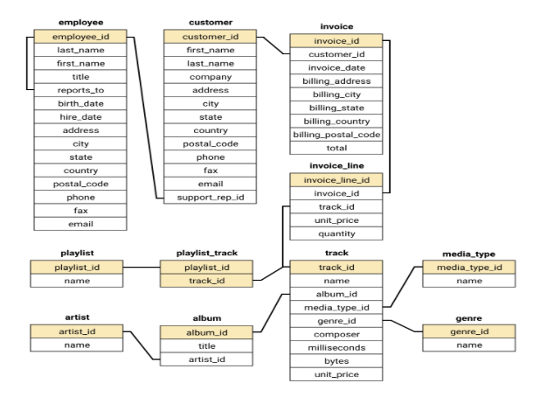

Slide 6
Methodology
01 Undetstanding data
02 Cleaning data
03 Exploring data
04 Insights and recommendation

Slide 7
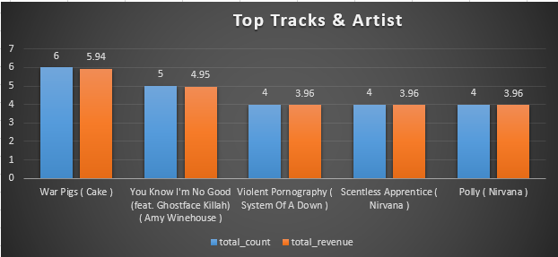
TOP TRACKS & ARTISTS (USA)
War Pigs by Cake (Alt) is the best-selling track — 6 purchases, $5.94
Nirvana and Amy Winehouse also rank among top contributors
Genres led by Alternative, R&B/Soul, Metal, and Rock
Sales spread indicates opportunity to promote emerging artists
Insight: Sales spread across a few artists; Nirvana and Amy Winehouse stand out.
Recommendation: Invest in artist-focused promotions and exclusive deals.

Slide 8
CUSTOMER DEMOGRAPHICS
Strongest presence in USA and Canada
High concentration in urban hubs like Prague, São Paulo, Paris, Berlin, and London
Data lacks age and gender details, so insights are location-focused
Insight: Strongest base in USA/Canada; customer presence is urban-heavy.
Recommendation: Target campaigns in major cities to boost conversion.

Slide 9
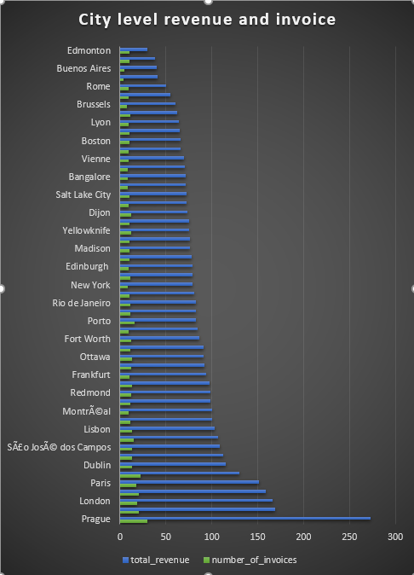
REVENUE & INVOICES BY CITY
Prague leads with 30 invoices, $273.24 in revenue
Mountain View (USA) follows with 20 invoices, $169.29
London, Berlin, and Paris contribute ~$150–166 each
Mid-tier cities: Dublin, Delhi, Lisbon ~$100–115
Several smaller cities add less than $50 each
Insight: Prague and Mountain View are top revenue hubs; Europe shows strong mid-tier cities.
Recommendation: Strengthen engagement in high-revenue cities with localized offers.

Slide 10
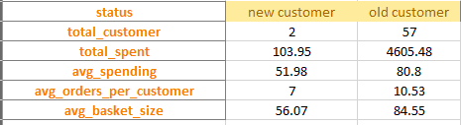
CUSTOMER BEHAVIOR
Long-term customers: Revenue ≈ $4,605, Avg basket ≈ 84.6
New customers: Revenue ≈ $104, Avg basket ≈ 56.1
Long-term buyers place more orders (10.5 vs. 7.0)
Retention of loyal customers is critical for sustained growth
Insight: Long-term customers contribute ~97% of total revenue.
Recommendation: Prioritize retention and loyalty programs over new acquisition.

Slide 11
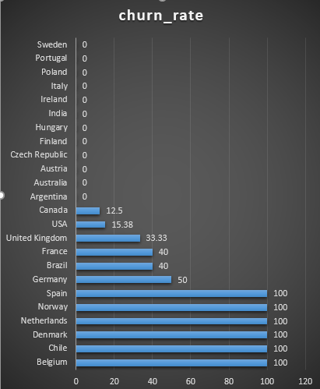
CHURN ANALYSIS
Global churn rate = 27.1% (~1 in 4 inactive after 6 months)
USA and Canada stable with churn below 16%
Germany (50%) and France/Brazil (40%) show high churn risk
Some smaller markets record 100% churn but with very few customers
Recommendation: Launch retention campaigns in high-churn regions.

Slide 12
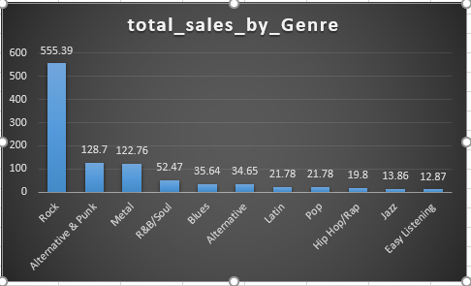
GENRE & ARTIST INSIGHTS (USA)
Rock dominates with 11.8% of sales (~$555)
Alternative & Punk ($128.7) and Metal ($122.8) are strong secondary genres
Top Rock Artists: Queen, Jimi Hendrix, Nirvana
Top Metal Artists: Metallica, Godsmack, System of a Down
Least popular genres: Latin and Pop
Recommendation: Diversify promotions across Rock and emerging genres.

Slide 13
GENRE INSIGHTS (OUTSIDE USA)
North America (Canada): Rock leads, Metal is strong #2.
South America (Brazil, Argentina, Chile): Rock dominates; Alternative & Punk is the common #2.
Europe:
Rock is consistently #1 across most countries.
Metal is the most frequent #2 (Germany, France, Belgium, Sweden, etc.).
Jazz, Blues, and Latin appear as niche #2 genres in some markets.
Asia (India): Rock #1, Alternative & Punk #2.
Oceania (Australia): Rock #1, Alternative & Punk #2.
Takeaway:
Rock is the universal anchor genre across regions.
Secondary genres differ by region → Metal dominates in Europe, while Alt & Punk is stronger in South America, India, and Australia.

Slide 14
PRODUCT AFFINITY (CROSS-SELL)
Strong pairings: Rock ↔ Metal (871), Rock ↔ Alt & Punk (520)
Artist clusters include Green Day, Foo Fighters, Nirvana, RHCP
Albums like Mezmerize and My Generation show strong co-purchase links
Cross-sell bundles can increase order value
Insight: Rock↔Metal and Rock↔Alt & Punk show strong co-purchase links.
Recommendation: Introduce bundles and recommendation engines to boost order value.

Slide 15
RISK PROFILING
High risk: inactive >180 days
Medium risk: low-frequency buyers
Low spender: frequent but low-value purchases
Low risk: loyal and consistent high spenders
Countries with many high-risk, low-value customers: Canada, Denmark, Argentina, Italy, USA, Belgium

Slide 16
RISK DRIVERS:
Recency: Long inactivity is the strongest churn signal.
Value: Low total spend despite multiple purchases = low ROI customers.
Country effect: Markets like Canada, USA, Germany, France have both high-value low-risk and high-risk clusters → mixed segments.
TAKEAWAY
Most likely to churn: High-risk inactives & low spenders.
Most stable: Recently active, high-value customers (Czech, Ireland, India).
Strategy:
Win-back inactive high-value customers with strong offers.
Convert low spenders via bundles, cross-sell, and discounts.

Slide 17
ALBUM RECOMMENDATIONS (USA)
Insight: 3 albums lead in USA sales (Wishkah Live, Are You Experienced, Green).
Recommendation: Feature these albums in targeted U.S. promotions.

Slide 18
ALBUM RECOMMENDATIONS (USA)
Insight: 3 albums lead in USA sales (Wishkah Live, Are You Experienced, Green).
Recommendation: Feature these albums in targeted U.S. promotions.

Slide 19
RECOMMENDATIONS
Launch loyalty programs to retain long-term customers
Run win-back campaigns for inactive high-value customers
Promote USA market with top Rock and Alt albums
Expand presence in Czech Republic, Ireland, India (high spenders)
Re-engage Germany, Brazil, France to reduce churn
Use affinity-based cross-sell (Rock ↔ Metal bundles, artist pairings)

Slide 20
THANK YOU

